Slide 1

SY2019-20 USDA Foods Entitlement Survey Webinar

Slide 2
Welcome!
“Listen only” mode
Webinar posted on Super Co-Op website today or tomorrow
Call Cynthia Barcelo with questions
CynthiaBarcelo@Super-Coop.org (909) 843-9600 x770

Slide 3
USDA Foods
Catalog
USDA FDP
Co-Op
Pre-Planner
California FDP
Due February 28
Member District
Survey
Co-Op Administration
Request Process
Due @ 5PM February 22
Co-Op Members

Slide 4


Slide 5
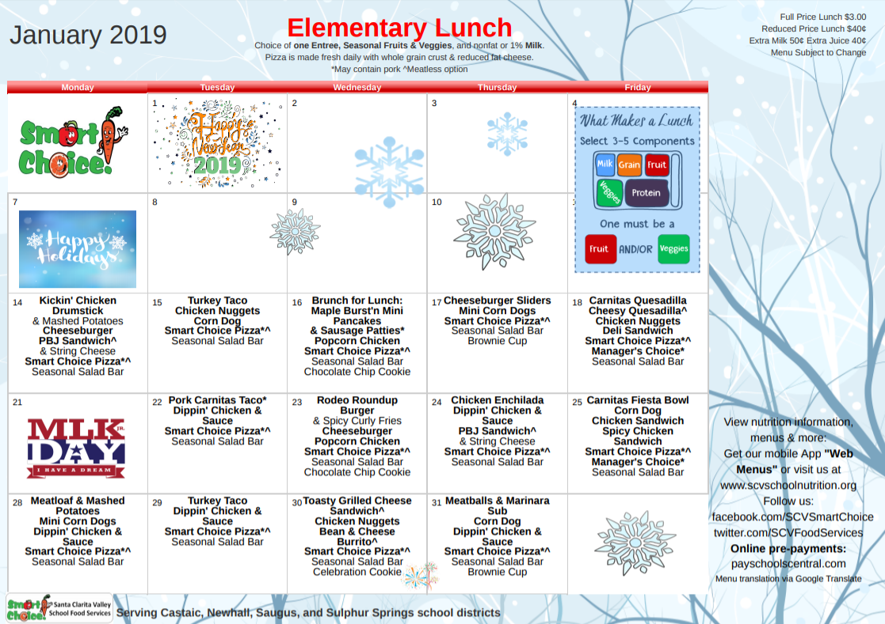
Menu Analysis
Your menu is the basis for all diversion decisions
Maximize use of USDA Foods of most value to your district

Slide 6
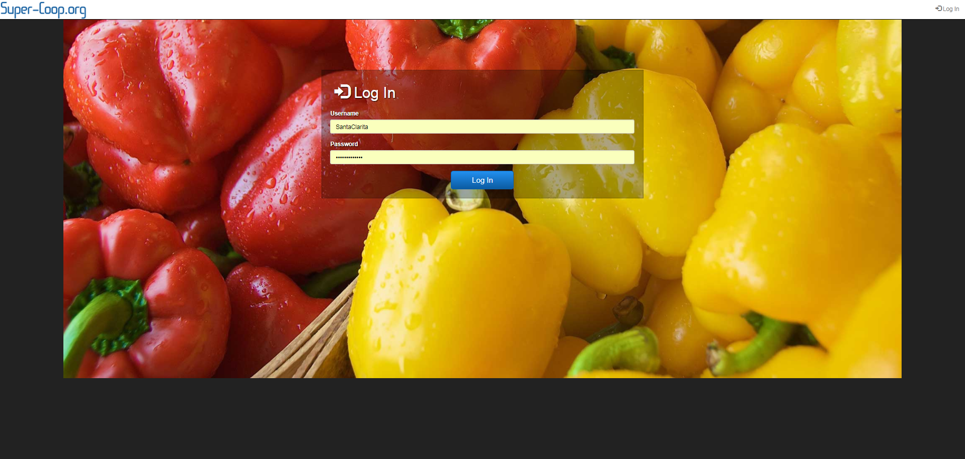
Launch www.Super-Coop.org
Log In to your Dashboard

Slide 7
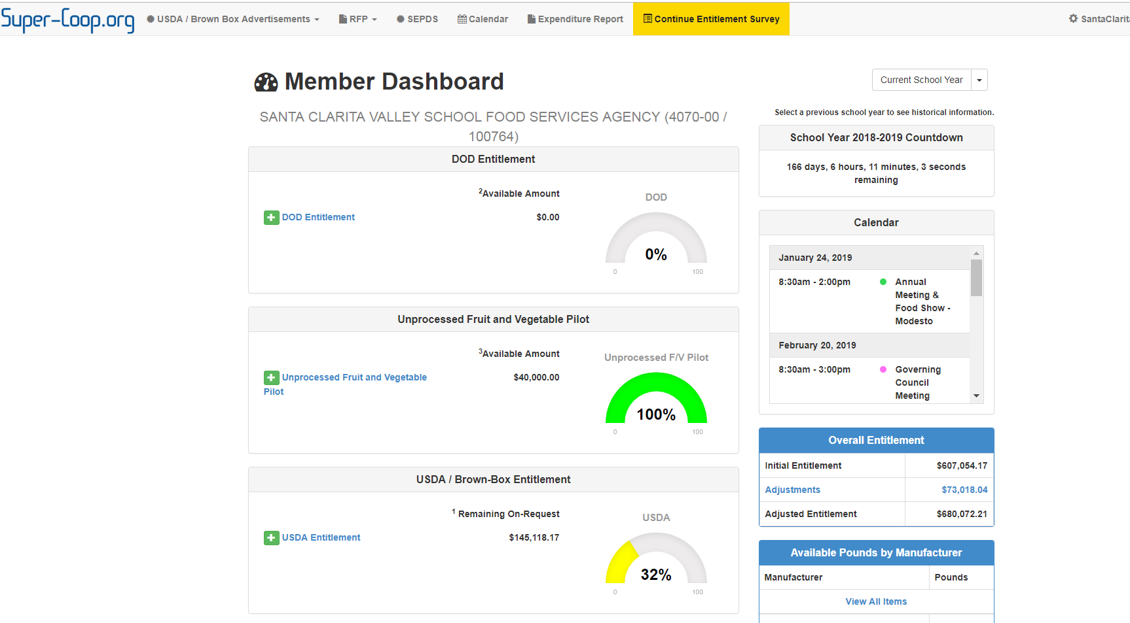

Click “Begin Entitlement Survey”

Slide 8
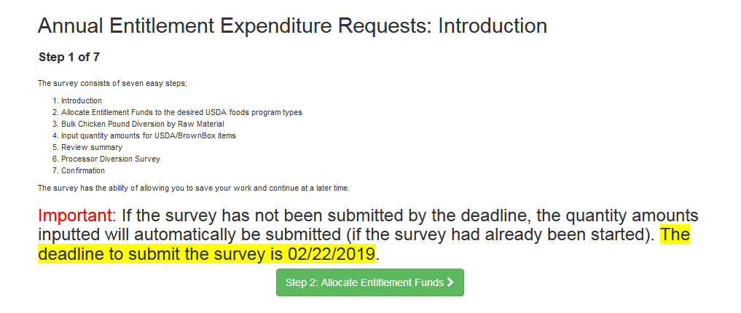
Seven Easy Steps

Slide 9
Step 1 - Introduction
Save your work after each step
Return to finish any time
Deadline – Friday, February 22, 2019
Important: If the survey has not been submitted by the deadline, the quantity amounts inputted will automatically be submitted.

Slide 10
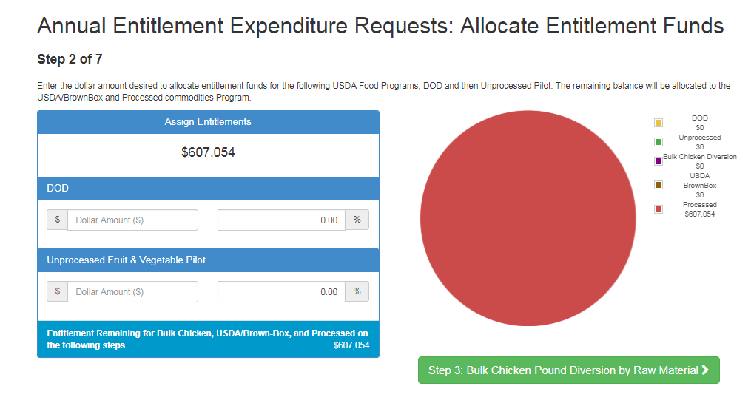
Step 2 – Assign Entitlement

Slide 11
Step 2 – Assign Entitlement

Slide 12
Step 2 – Assign Entitlement

Slide 13
Unprocessed Fruit and Vegetable Pilot
School | Vendor # | Entitlement set aside
Cupertino Union SD | 694100 | $30,000
Brentwood Union School Dist | 616500 | $25,000
Granada Hills Charter HS | C57200 | $37,500
Hawthorne School District | 645900 | $20,000
Lodi Unified SD | 685800 | $25,000
Madera Unified School District | 652400 | $250,000
Modesto City Elementary SD | 711600 | $290,000
Monterey Peninsula Unified SD | 660900 | $75,000
Natomas Unified SD | 752800 | $50,000
Oxnard Union High SD | 725400 | $90,000
Santa Ana Unified SD | 666700 | $400,000
Santa Clarita Valley Sch Food Svs | 407000 | $40,000
Upland Unified School District | 750600 | $50,000
Vista Unified School District | 684500 | $90,000

Slide 14
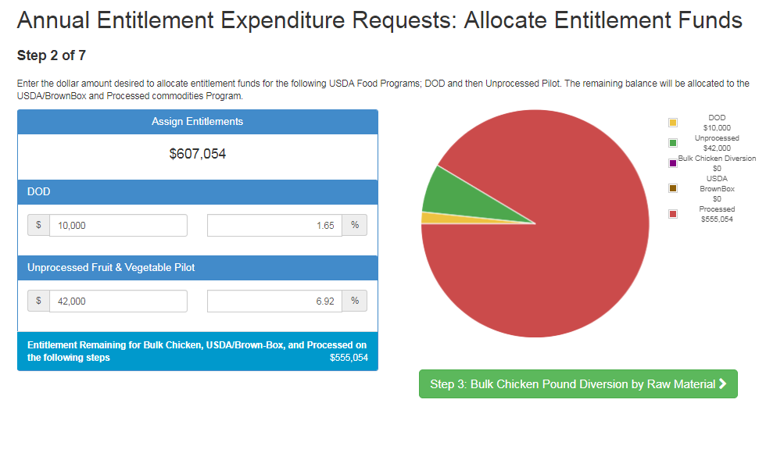
Step 2 – Assign Entitlement

Slide 15
Step 2 – Assign Entitlement

Slide 16
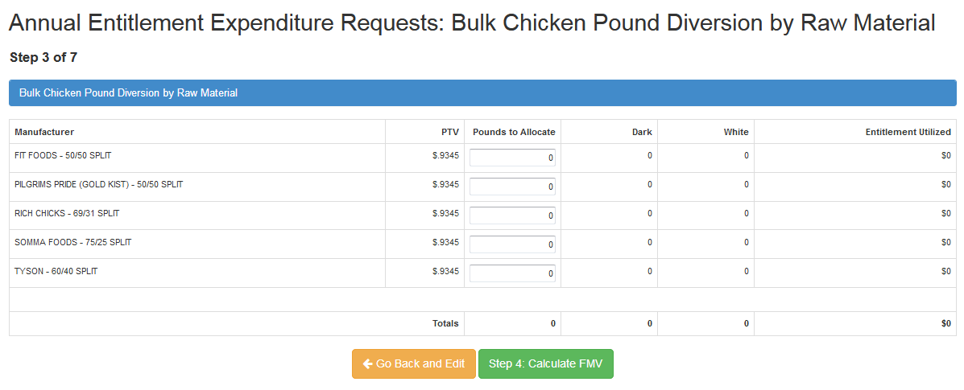
Step 3 – Chicken Diversion
Select chicken processor(s) of choice
No need to order chicken for bone-in parts
Order by pounds for all processors

Slide 17
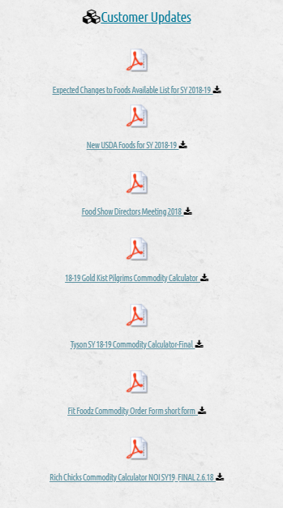
Step 3 – Chicken Diversion
No carry-over from SY2018-19
Calculators at www.Super-Coop.org home page
Maximize use of USDA Foods of most value to your district

Slide 18
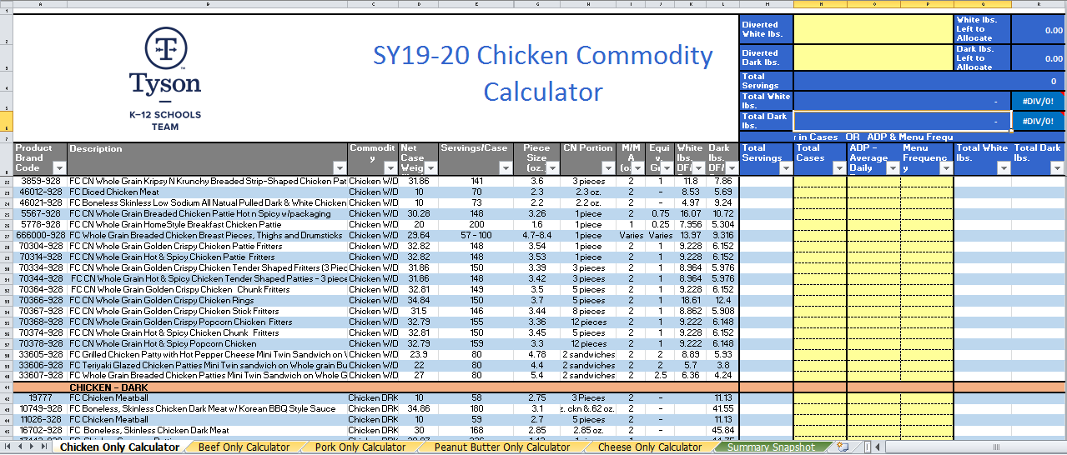
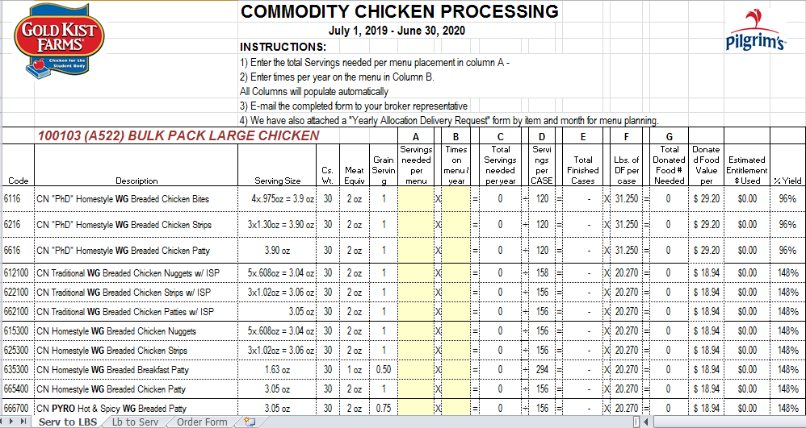

Slide 19
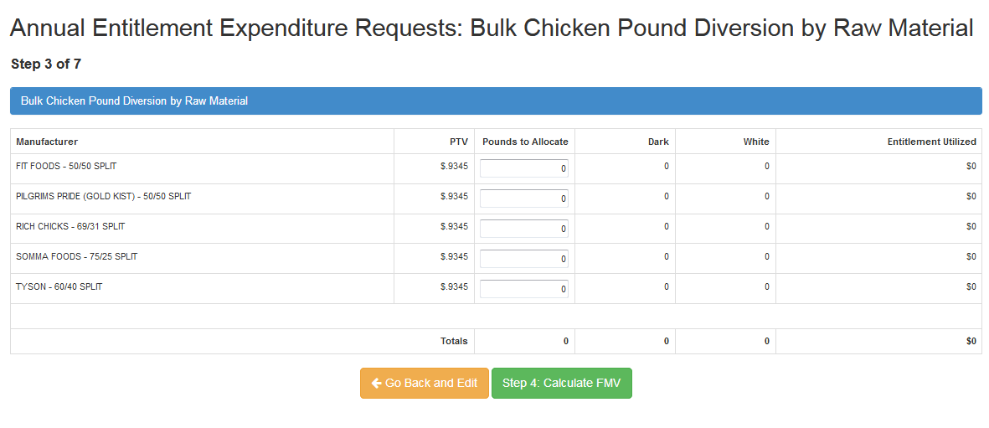
Step 3 – Chicken Diversion

Slide 20
Step 4 – Select Brown Box Items
Some items have limited availability
USDA cancellations happen
New items for 2019-20

Slide 21
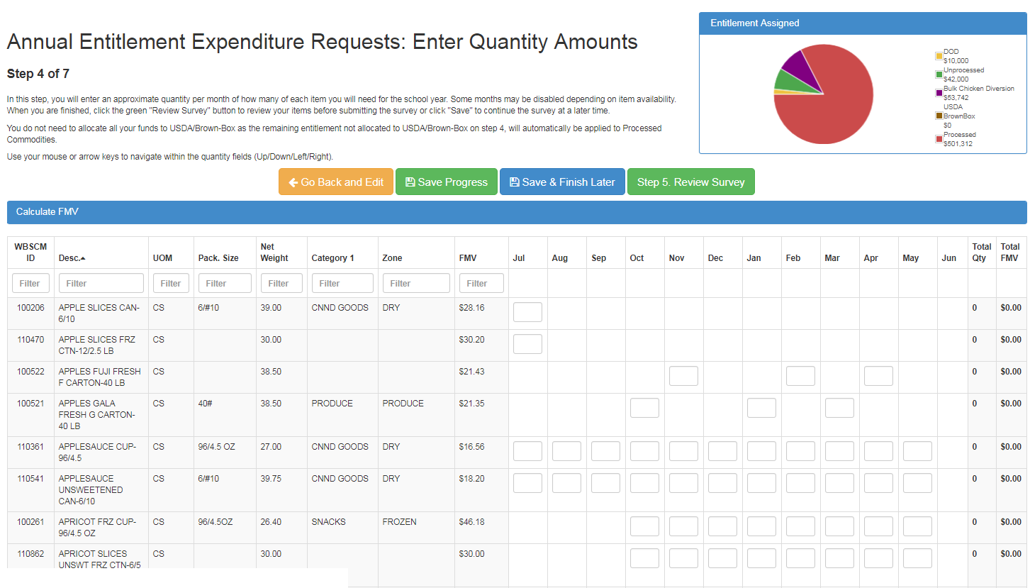
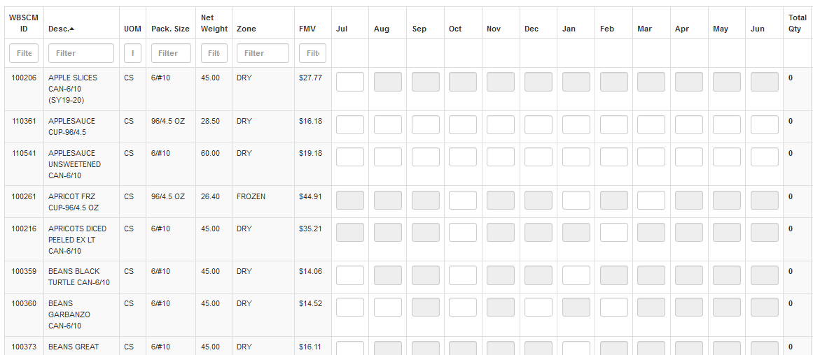
Step 4 – Select Brown Box Items

Slide 22
New Brown Box Items for 2019-20

Slide 23
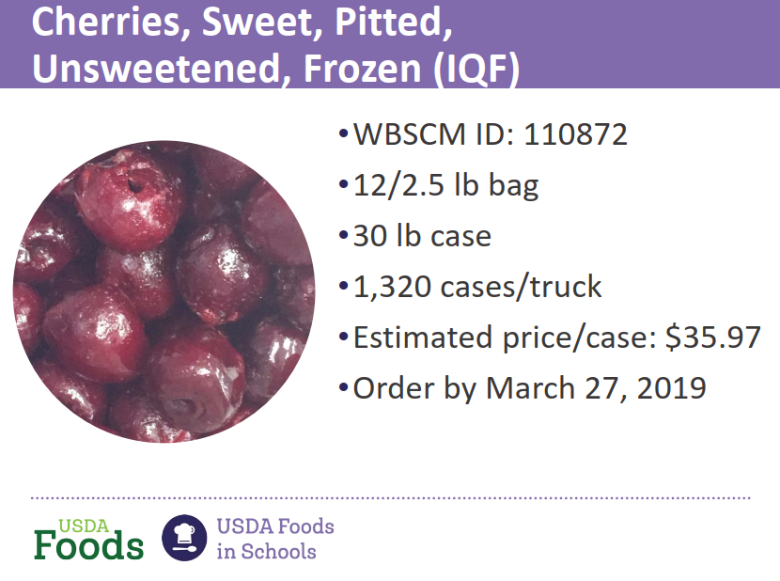
23

Slide 24
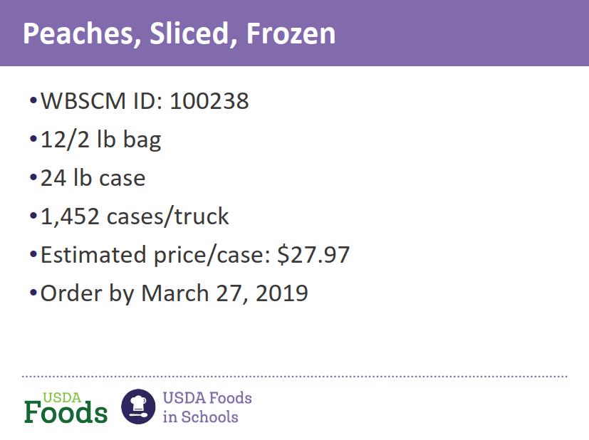

24

Slide 25
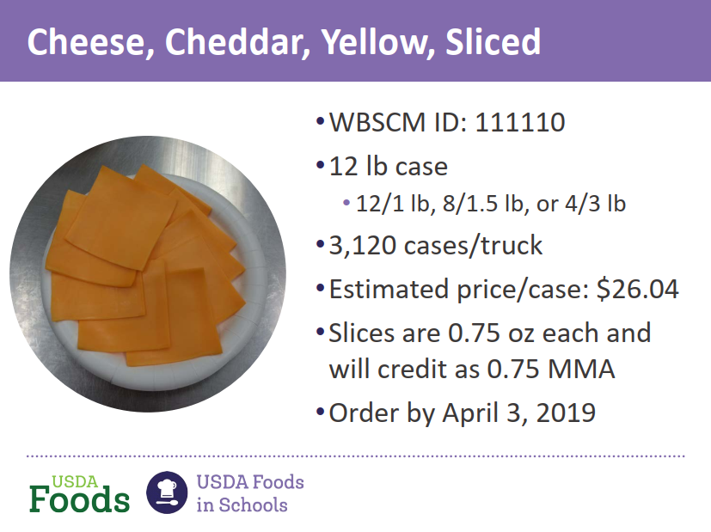
27

Slide 26
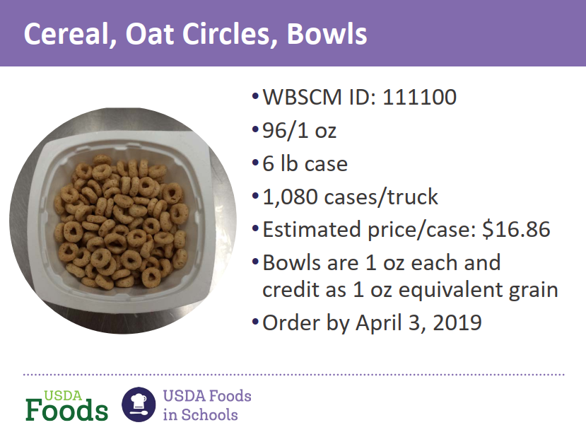
28

Slide 27
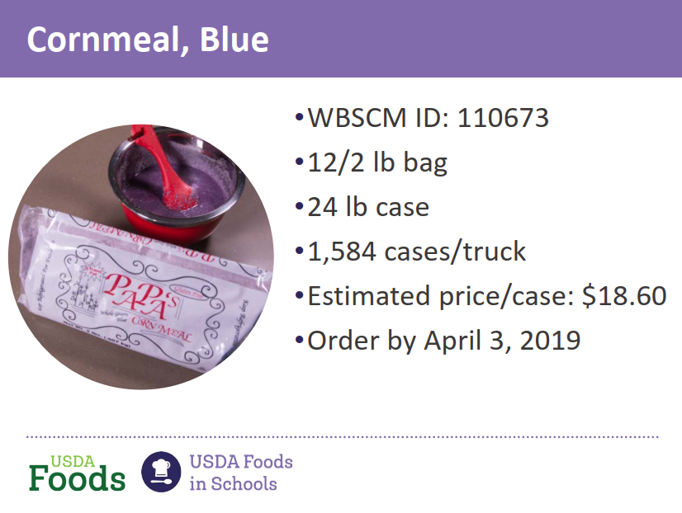
29

Slide 28
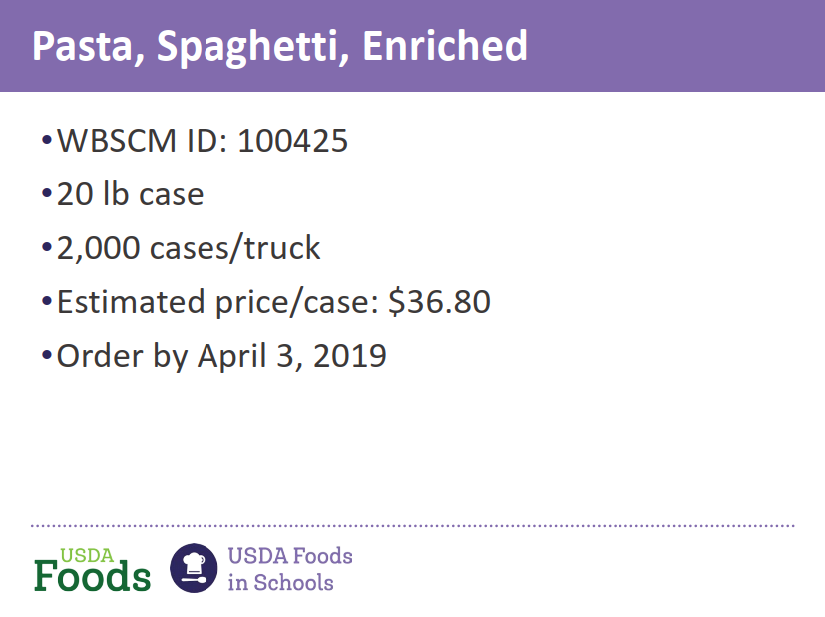
29

Slide 29
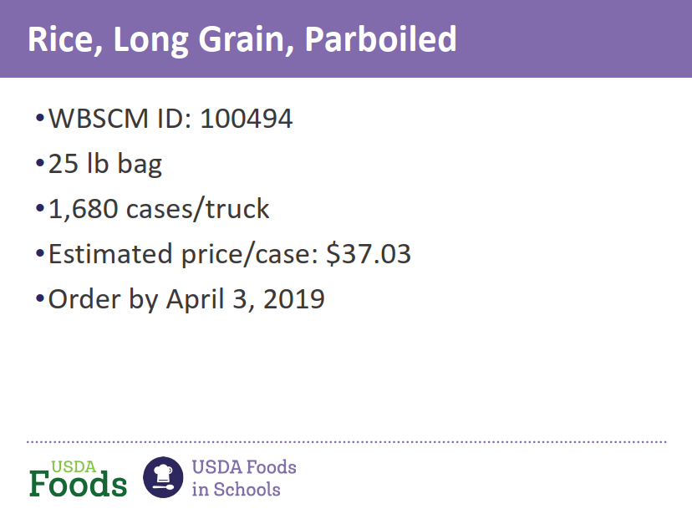
29

Slide 30
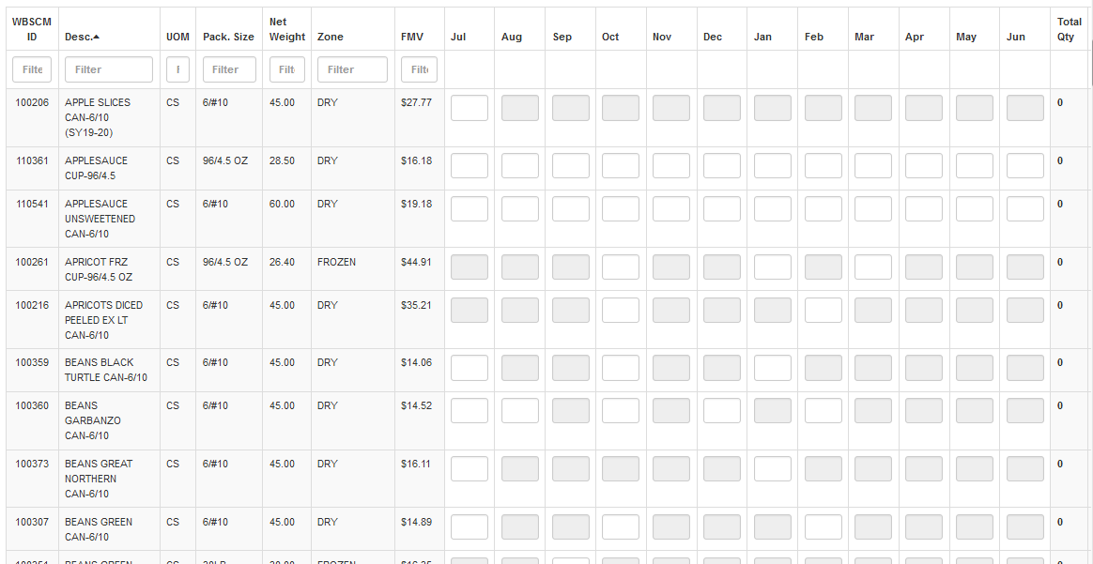
Step 4 – Select Brown Box Items

Slide 31
Step 4 – Select Brown Box Items

Slide 32
Step 4 – Select Brown Box Items

Slide 33
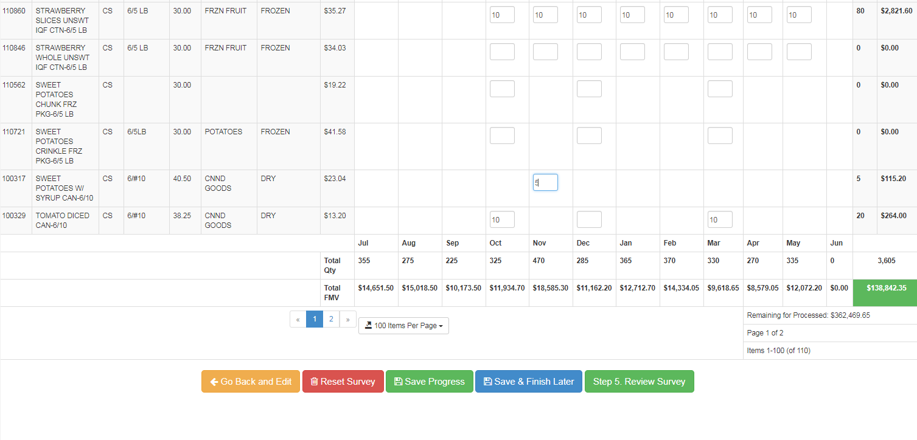
Step 4 – Select Brown Box Items
2 pages

Slide 34
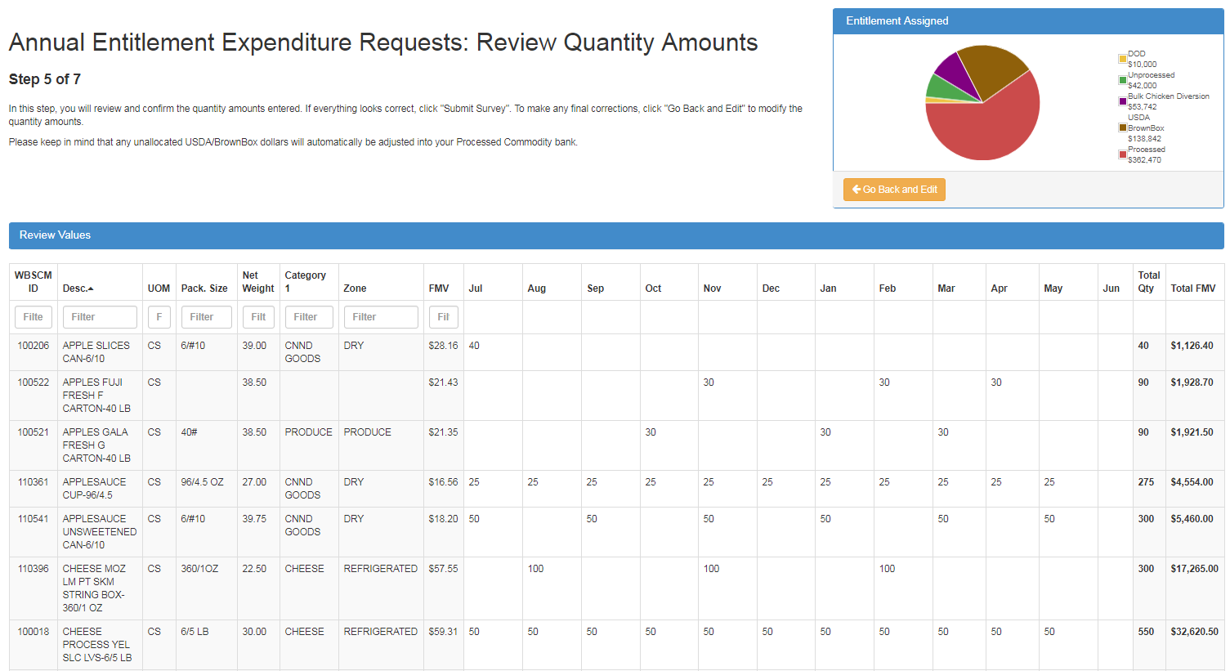
Step 5 – Review Quantity Amounts

Slide 35
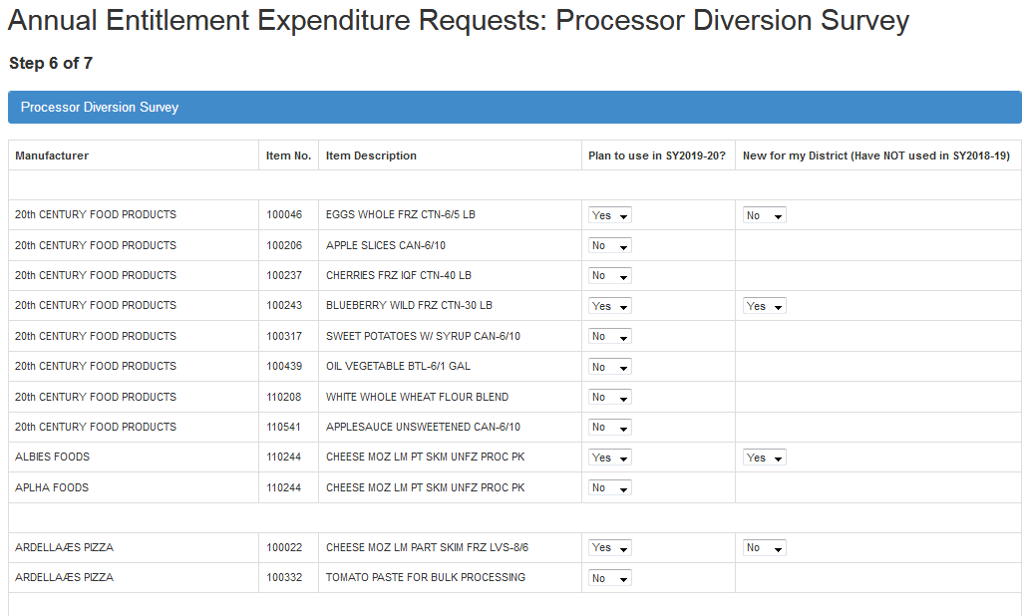
Step 6 – Processor Survey

Slide 36
Step 6 – Processor Survey

Slide 37
Step 6 – Processor Survey
One company => many names
ADVANCE PIERRE (TYSON FOODS)
CARGILL KITCHEN SOLUTIONS (Sunny Fresh)
CONAGRA FOODS (GILARDI FOODS)
ES FOODS (formerly East Side Entrees)
FOSTER FARMS (FERNANDOS)
GARDEN BANNER (PREMIER FOOD AND OILS)

Slide 38
Step 6 – Processor Survey
One company => many names
M.C.I. FOODS, INC. (LOS CABOS)
MICHAEL B'S (BEST EXPRESS FOODS)
PIAZZA (S.A. PIAZZA & ASSOC.) - WILD MIKES
PILGRIMS PRIDE (Goldkist)
TYSON FOODS (BOSCO'S, Advance Pierre)
VELMAR FOODS (ARIZONA GOLD)
YANG'S (FORMERLY LING'S)

Slide 39
Step 6 – Processor Survey
New processor in large quantities
Please notify Lynnelle Grumbles
LGrumbles@scvsfsa.net

Slide 40
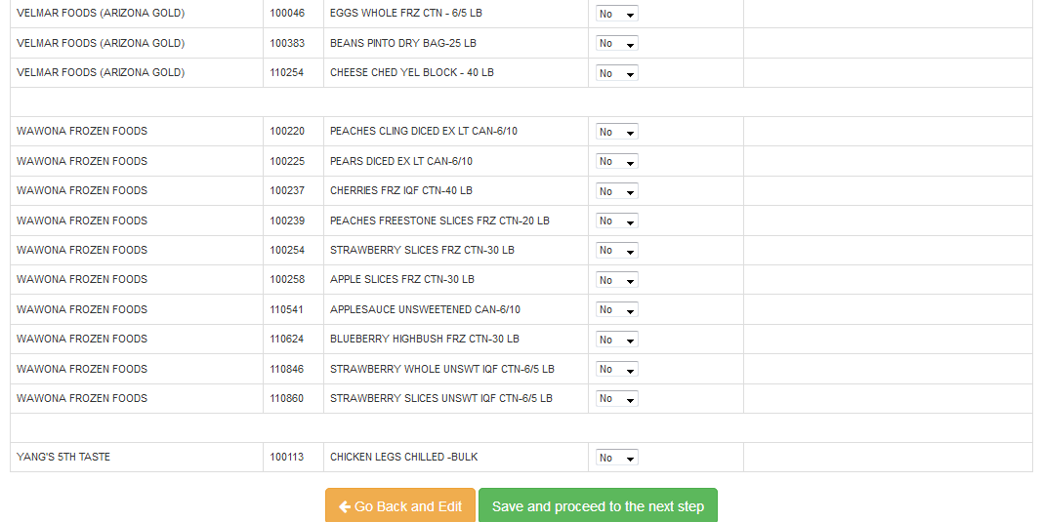
Step 6 – Processor Survey

Slide 41
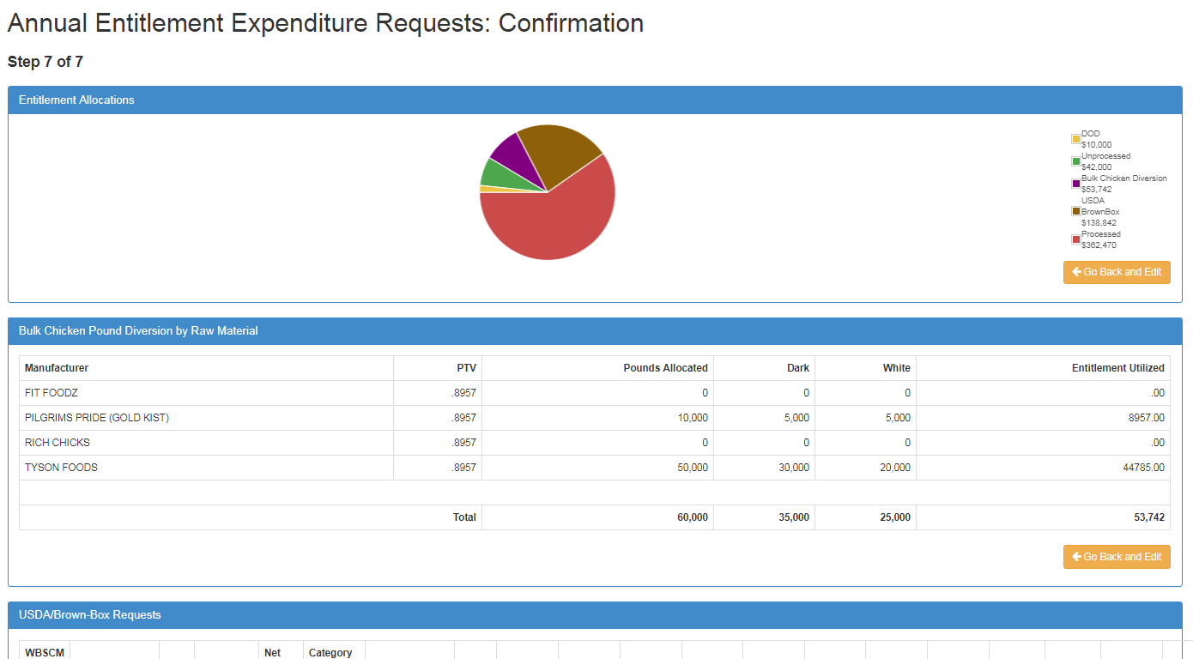
Step 7 - Confirmation

Slide 42
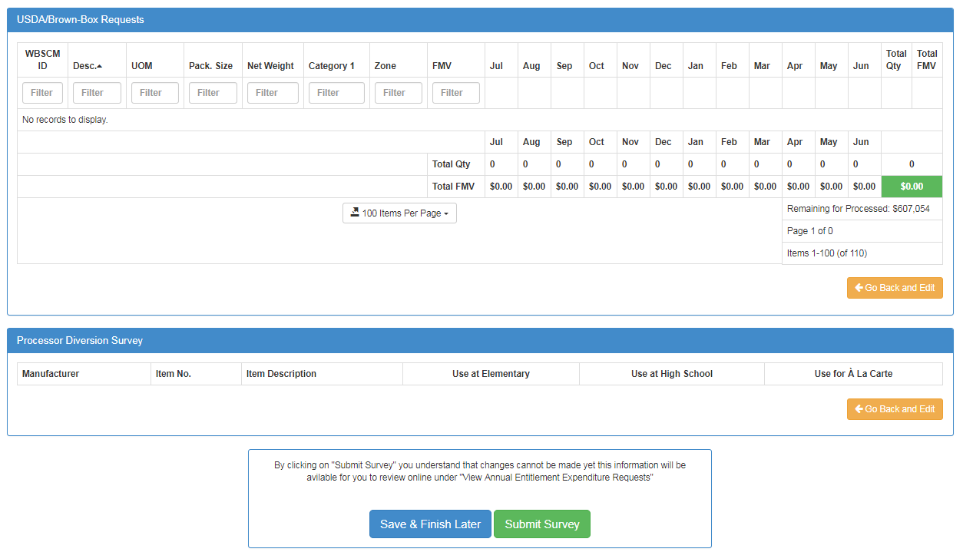
Step 7 - Confirmation

Slide 43
SY2019-20 USDA Foods Survey
Due 5:00PM
Friday February 22, 2019

Slide 44
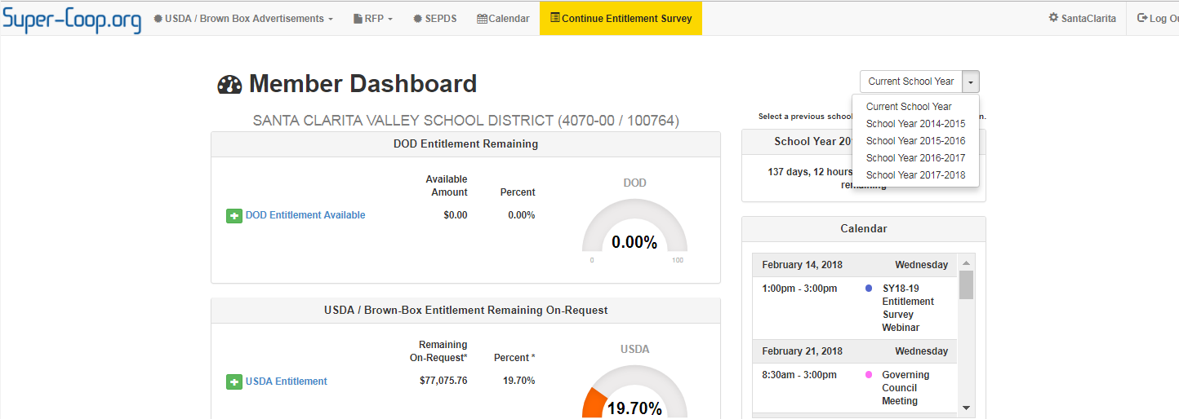
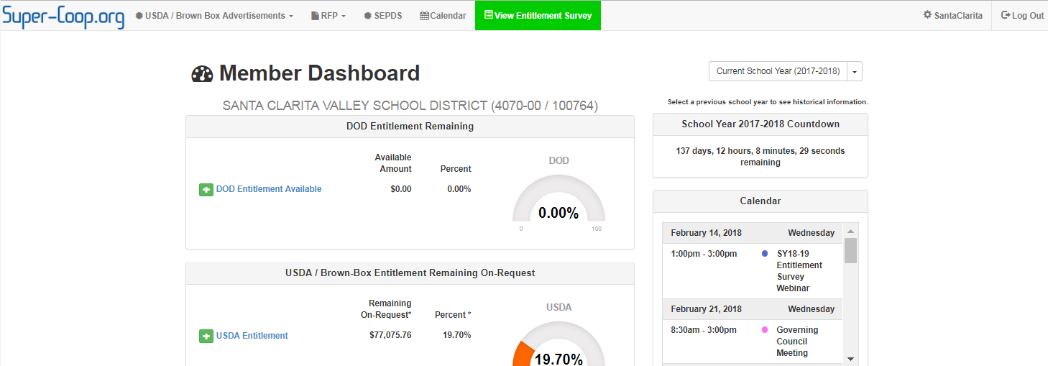
What did I request last year?

Slide 45
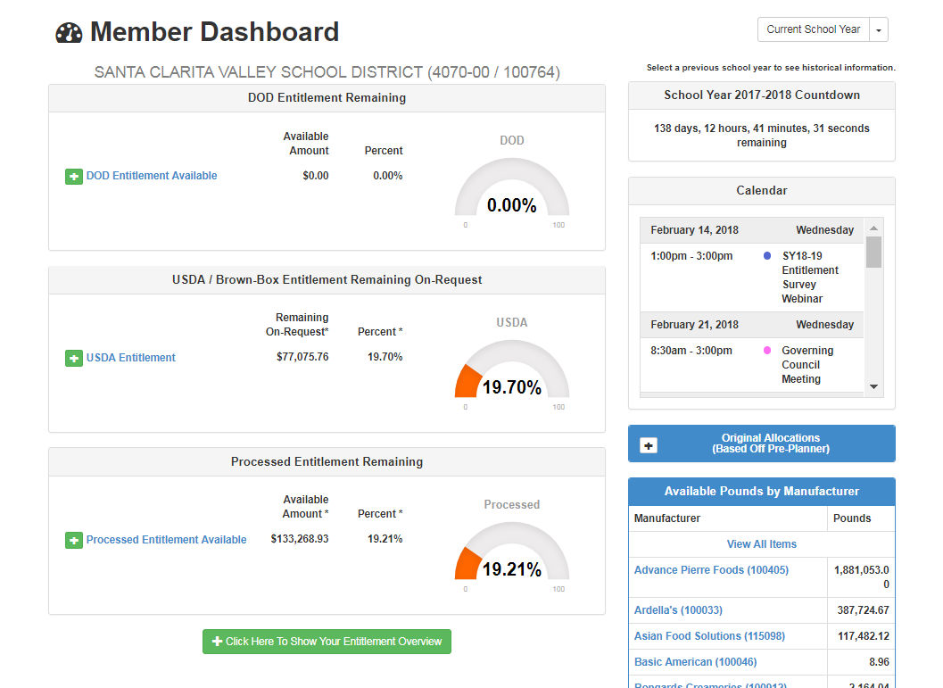
How do I know if pounds are available at a processor?

Slide 46
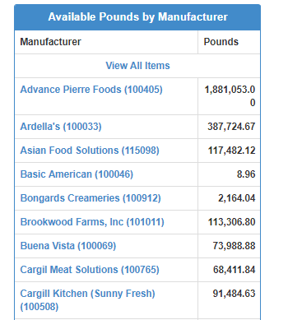
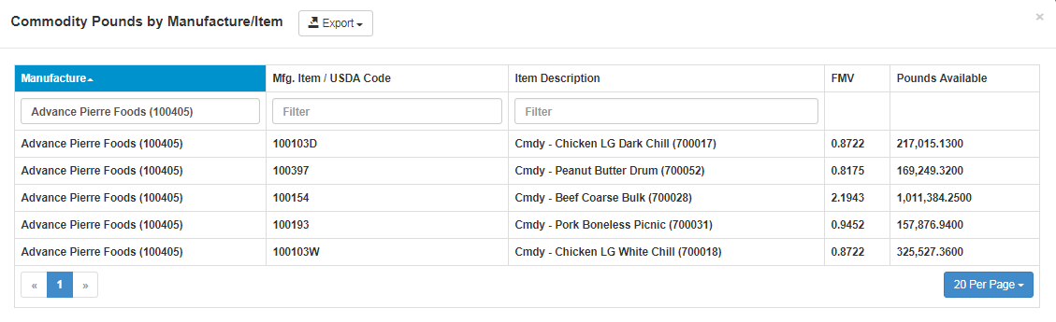
How do I know if pounds are available at a processor?

Slide 47
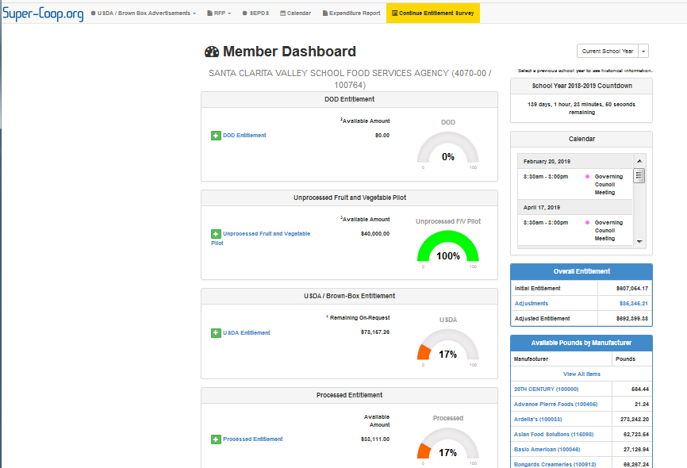
How do I know what Brown Box is coming?

Slide 48
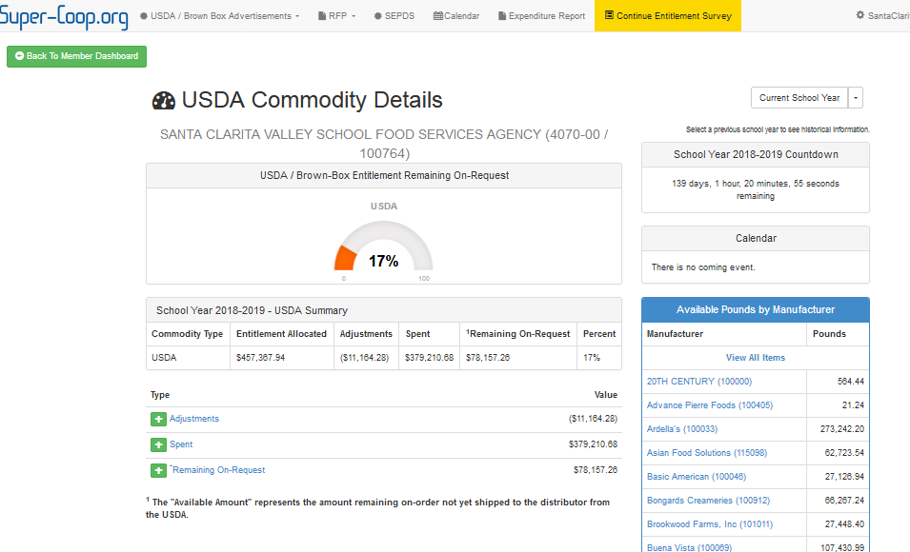
How do I know what Brown Box is coming?

Slide 49
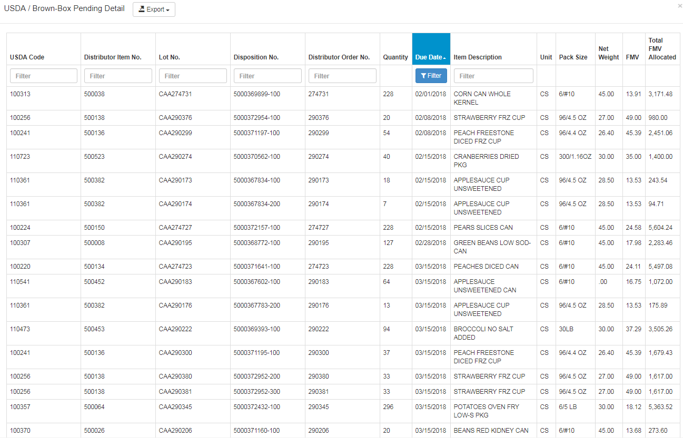
How do I know what Brown Box is coming?

Slide 50
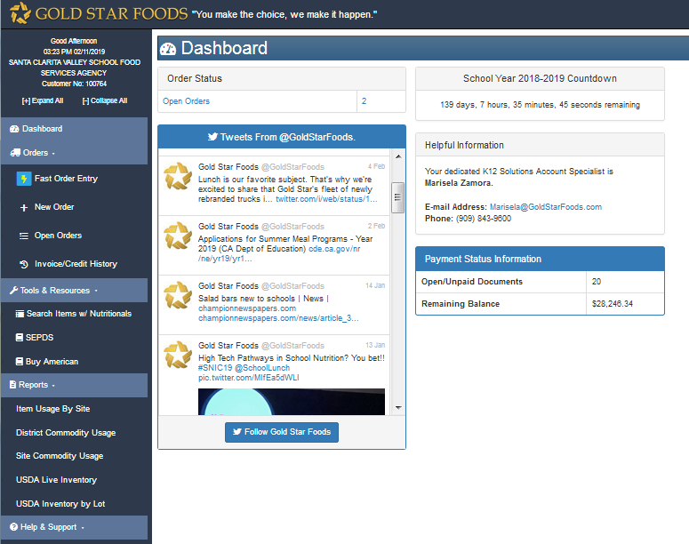
How do I know what Brown Box is in inventory at Gold Star?

Slide 51
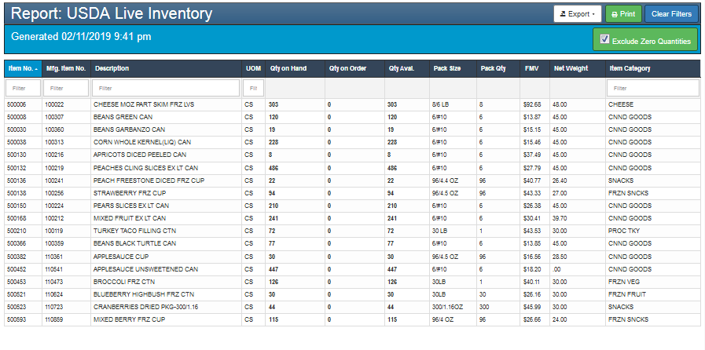
How do I know what Brown Box is in inventory at Gold Star?

Slide 52
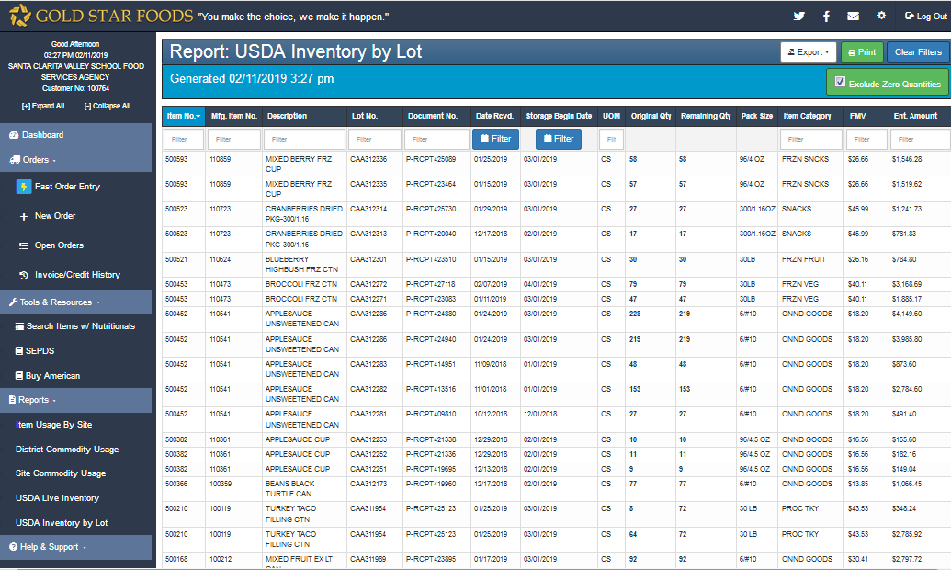
How do I Know when I will begin paying storage charges?

Slide 53

When you want it

Slide 54
Lynnelle Grumbles Lead Agency Santa Clarita Valley School Food Services Agency LGrumbles@scvsfsa.net (661) 295-1574 x103 Cynthia Barcelo Super Co-Op Administrator Gold Star Foods/Super Co-Op CynthiaBarcelo@Super-Coop.org (909) 843-9600 x770

